Slide 1
Inquiry Lab #1
Find the thickness of zinc coating on galvanized metal
DISCUSSION

Slide 2
Questions
What source(s) of random error may have affected the gathering of your data?
What concepts was the lab investigating?

Slide 3
Why are significant figures important?
SF are important in calculations. A maximum of one point in the free-response sections will be deducted for errors in SF that are off by +1 SF.
The SF of a measurement are all of the certain digits in a measurement, those that represent actual marks on the measuring instrument, and the first uncertain digit (estimated number) . You must be able to read measurements to the proper number of SF.

Slide 4
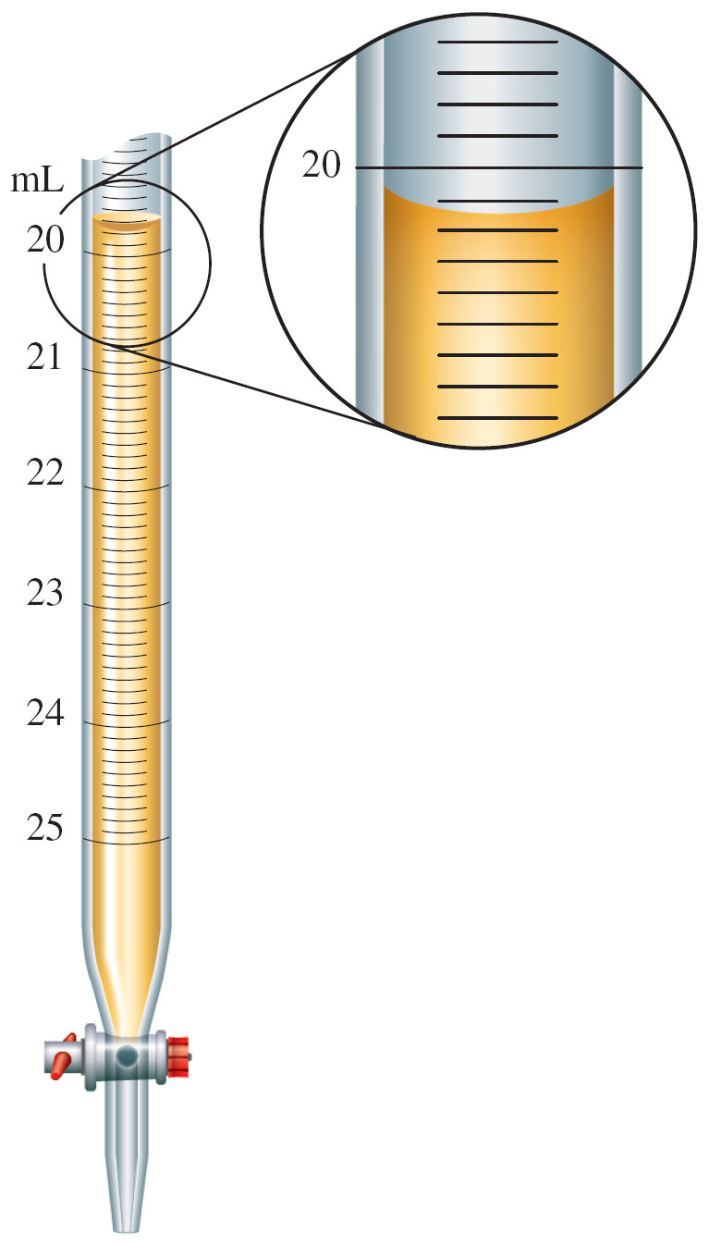
Figure 1.7: Measurement of Volume Using a Buret

Slide 5
Measurement of Volume Using a Buret
The volume is read at the bottom of the liquid curve (meniscus).
Meniscus of the liquid occurs at about 20.15 mL.
  Certain digits: 20.15
  Uncertain digit: 20.15

Slide 6
Precision & Accuracy
Accuracy refers to the agreement of a particular value with a true value.
Precision refers to the degree of agreement among several measurements of the same quantity. The degree of precision refers to the number of digits that a measuring device permits one to measure. In a measuring device, all except the last digit, which is estimated, are certain.
For example, a balance which measures to the nearest 0.0001 g is more precise than one that measures to the nearest 0.01 g.

Slide 7
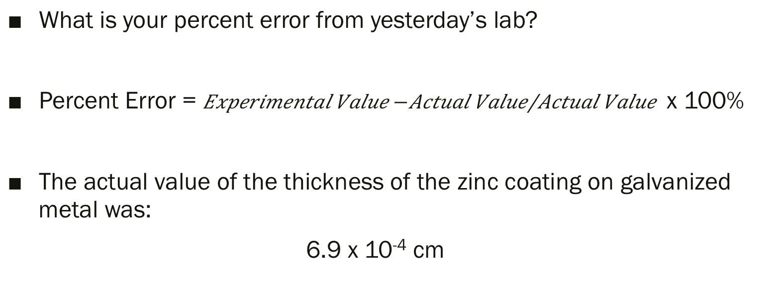
Percent Error
What is your percent error from yesterday’s lab?
Percent Error = $\frac{Experimental Value −Actual Value}{Actual Value}$ x 100%
The actual value of the thickness of the zinc coating on galvanized metal was:
6.9 x 10⁻⁴ cm

Slide 8
Significant Figures in Calculations
Review section 1.5 in textbook.

Slide 9
Dimensional Analysis
Dimensional analysis, or unit analysis, is used to convert from one unit to another.
For the Constructed Response Questions on the AP Exam, “your responses to these questions will be scored on the basis of accuracy and relevance of the information cited… For calculations, clearly show the method used and the steps involved in arriving at your answers. It is to your advantage to do this, since you may obtain partial credit if you and you will receive little to no credit if you do not”. THE COLLEGE BOARD, 2013

Slide 10
Break

Slide 11
Inquiry Activity #2
Design an experiment to collect data that supports the claim that 1.0 M NaCl solution is a homogenous mixture. Describe the steps, the data you would collect, and how the data support the claim. Laboratory equipment for your experiment can be taken from the list below. (You may not need all of the equipment. You may think of another piece of equipment not on the list.)
50-mL beaker Drying oven Volumetric pipettes (5,10,25 mL)
Hot plate Stirring rod Balance
100 mL of 1.0 M NaCl Fume hood

Slide 12
Inquiry Activity #2
What content knowledge should you have in order to successfully support the claim? Explain your answer.
Which science practices should you have to demonstrate in order to successfully answer the question? Explain your choices.

