Slide 1
Stoich Flip book

Slide 2
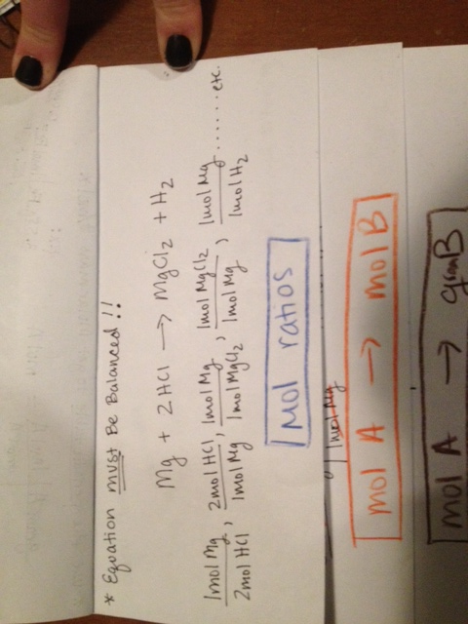
mol ratios

Slide 3
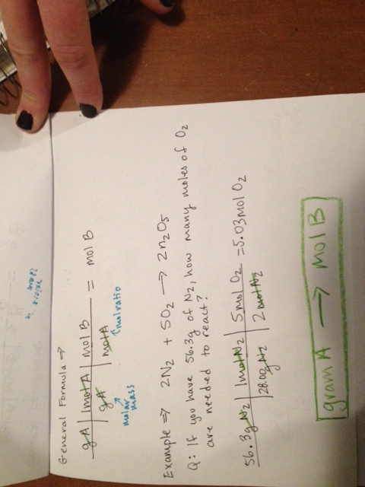
gram A to mol B

Slide 4
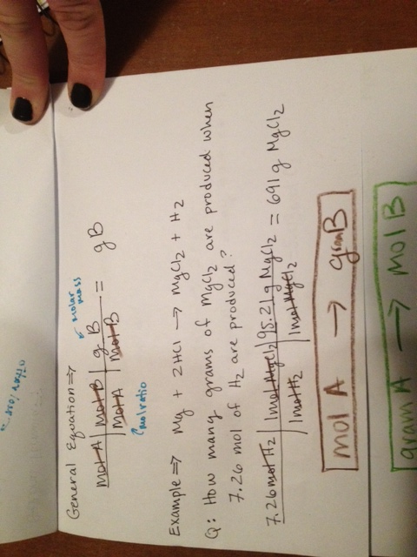
mol A to gram B

Slide 5
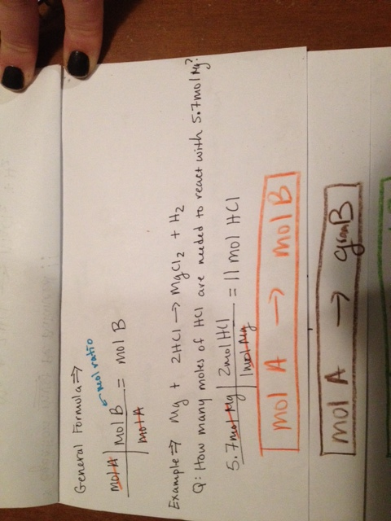
mol A to mol B

Slide 6
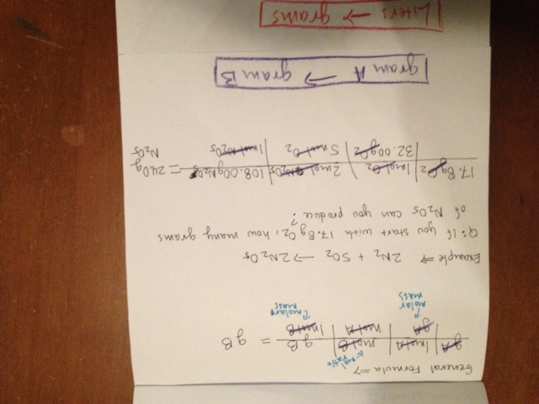
Gram A to gram B

