Slide 1
Answer in your notebook:
Look at the “Barometer” up front.
How does it work?
Why is the water not moving?
How did the balloon in flask happen?
How did I do this?

Slide 2
Pressure Units
Convert 687 torrs into atmospheres.
1 torr = 1mm Hg
1 atm = 760 mm Hg
1 atm= 101.325 KPa

Slide 3
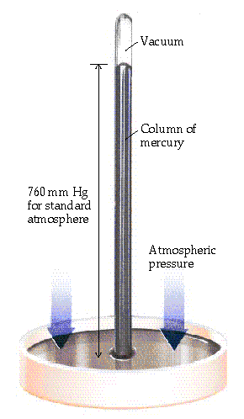
Pressure
Pressure of air is measured with a BAROMETER (developed by Torricelli in 1643)
Hg rises in tube until force of Hg (down) balances the force of atmosphere (pushing up). (Just like a straw in a soft drink)
P of Hg pushing down related to
Hg density
column height

Slide 4
Pressure
Column height measures Pressure of atmosphere
1 standard atmosphere (atm) *
= 760 mm Hg (or torr) *
= 29.92 inches Hg *
= 14.7 pounds/in² (psi) *HD only
= 101.3 kPa (SI unit is PASCAL) * HD only
= about 34 feet of water!

Slide 5
Pressure Conversions
A. What is 475 mm Hg expressed in atm?
1 atm
760 mm Hg
B. The pressure of a tire is measured as 29.4 psi.
What is this pressure in mm Hg?
760 mm Hg
14.7 psi
475 mm Hg x
= 0.625 atm
29.4 psi x
= 1.52 x 10³ mm Hg

Slide 6
Pressure Conversions
A. What is 2 atm expressed in torr?
B. The pressure of a tire is measured as 32.0 psi.
What is this pressure in kPa?

Slide 7
Pressure depends on Temp
Today’s temp: 35°F
Today’s temp: 85°F
Pressure
Gauge
Pressure
Gauge

Slide 8
In Your Notes:
Create an algebraic expression for the relationship between pressure and temperature.

Slide 9
Practice problem
A bike tire has a pressure of 0.987 atm at a temperature of 25°C and a new pressure of 0.795 atm.

Slide 10
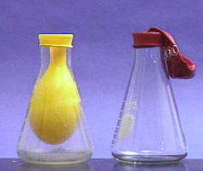
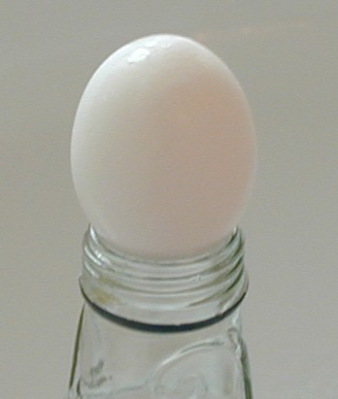
Demo: Gay-Lussac’s Law Egg in a bottle & Balloon in flask

Slide 11
Gay-Lussac
A sample of neon is at 89ºC and 123 kPa. If the pressure changes to 145 kPa and the volume remains constant, find the new temperature, in K.

Slide 12
P1 = P2 T2 = T1P2
T1 T2 P1 .
T2 = (362K) (145 kPa) .
(123 kPa)
T2 = 427 K
Gay-Lussac

