Slide 1
With your lab partner, use the following scenarios as a guide to come up with the four properties of gases.
Bicycle tires seem more flat in the winter than in the summer.
A can of soda explodes if left in the hot sun.
You blow air into a balloon and it gets bigger.

Slide 2
Properties of Gases
Gases can be described using the following four variables:
V = volume of the gas (liters, L)
P = pressure (atmospheres, atm)
T = temperature (Kelvin, K)
n = amount (moles, mol)
UNITS

Slide 3
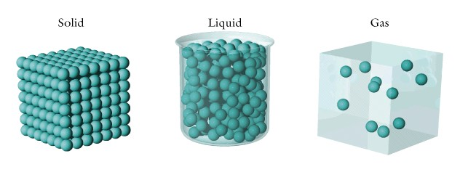
Tell me about:
  solids
  liquids
  gases

Slide 4
Solids: Students stay in place (no foot moving) and wiggle and jiggle and twist.
Liquids: Feet can take baby steps in any direction while their upper bodies are still wiggling and jiggling.
Gases: Have students cross their hands across their chests. Students move in a straight line as fast as they can until they hit a surface or another students and then they bounce off or reflect off in another direction until they hit something else.

Slide 5
Postulates of the KMT
Gases Consist of tiny particles (atoms or molecules)
The actual volume of gas particles is negligible. Particles are far apart. The volume of a gas is effectively the volume the particles occupy, not their particle volume.

Slide 6
3. Particles are in constant, random, straight line motion. Collisions with walls of their container generate pressure.
4. Gas particles do not attract or repel. Perfectly elastic collisions.
5. The average kinetic energy is directly proportional to the Kelvin temperature of the gas.

Slide 7
Kinetic Molecular Theory (KMT) of Gases
KMT is a model to explain the behavior of gaseous particles and is based on extensive observations of the behavior of gases.
If a gas follows all the postulates of the the KMT it is said to be an ideal gas.

Slide 8
The Kinetic Molecular Theory
In a perfectly elastic collision, the kinetic energy of each molecule might change, but the total kinetic energy stays the same.
Collisions between particles are elastic.

Slide 9
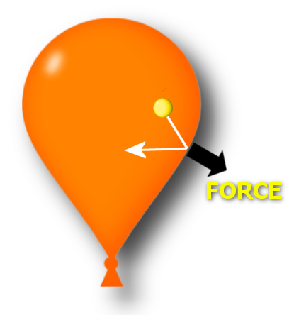
Pressure
One gas molecule exerts a tiny force against the side of a balloon.

Slide 10

Pressure
When you have a huge number of gas molecules colliding against the sides of a balloon, the force adds up. Force spread out over the inner surface of the balloon is pressure.

Slide 11
Kinetic Molecular Theory
Particles in an ideal gas…
  have no volume.
  have elastic collisions.
  are in constant, random, straight-line motion.
  don’t attract or repel each other.
  have an avg. KE directly related to Kelvin temperature.
Courtesy Christy Johannesson www.nisd.net/communicationsarts/pages/chem

Slide 12
Kinetic Molecular Theory
Postulates
Evidence
1. Gases are tiny molecules in mostly empty space. | The compressibility of gases.
2. There are no attractive forces between molecules. | Gases do not clump.
3. The molecules move in constant, rapid, random, straight-line motion. | Gases mix rapidly.
4. The molecules collide classically with container walls and one another. | Gases exert pressure that does not diminish over time.
5. The average kinetic energy of the molecules is proportional to the Kelvin temperature of the sample. | Charles’ Law
Notes:
The kinetic molecular theory of gases explains the laws that describe the behavior of gases and it was developed during the nineteenth century by Boltzmann, Clausius, and Maxwell
Kinetic molecular theory of gases provides a molecular explanation for the observations that led to the development of the ideal gas law
The kinetic molecular theory of gases is based on the following postulates:
1. A gas is composed of a large number of particles called molecules (whether monatomic or polyatomic) that are in constant random motion.
2. Because the distance between gas molecules is much greater than the size of the molecules, the volume of the molecules is negligible.
3. Intermolecular interactions, whether repulsive or attractive, are so weak that they are also negligible.
4. Gas molecules collide with one another and with the walls of the container, but collisions are perfectly elastic; they do not change the average kinetic energy of the molecules.
5. The average kinetic energy of the molecules of any gas depends on only the temperature, and at a given temperature, all gaseous molecules have exactly the same average kinetic energy.
Postulates 1 and 4 state that molecules are in constant motion and collide frequently with the walls of their container and are an explanation for pressure
1. Anything that increases the frequency with which the molecules strike the walls or increases the momentum of the gas molecules increases the pressure.
2. Anything that decreases that frequency or the momentum of the molecules decreases the pressure.
• Postulates 2 and 3 state that all gaseous particles behave identically, regardless of the chemical nature of their component molecules — this is the essence of the ideal gas law.
• Postulate 2 explains how to compress a gas — simply decrease the distance between the gas molecules.

Slide 13
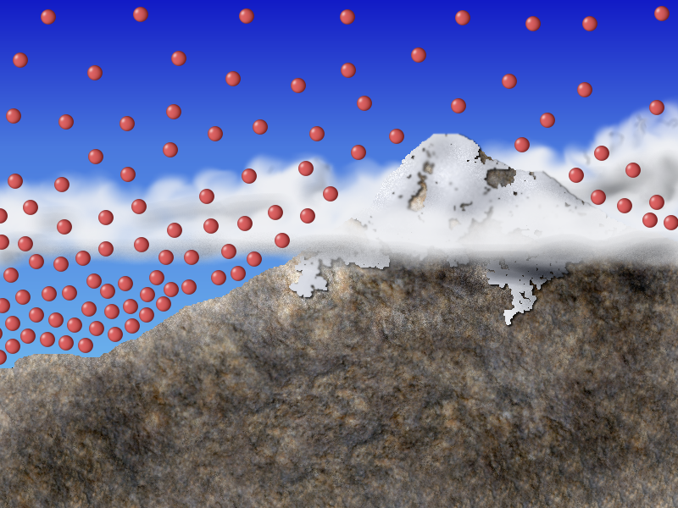
Atmospheric Pressure
As you move upward through the atmosphere, the density decreases. This is because most air molecules are held close to Earth’s surface by gravity. As the density decreases, there are fewer molecules colliding with surfaces; hence, less pressure.

Slide 14
Real Gases
Particles in a REAL gas…
  have their own volume
  attract each other
Gas behavior is most ideal…
  at low pressures
  at high temperatures
  in nonpolar atoms/molecules
Courtesy Christy Johannesson www.nisd.net/communicationsarts/pages/chem

Slide 15
Deviations from Ideality
➔Some gas particles do repel each other so volume is greater than predicted.
➔Some gas particles do attract each other so volume is reduced more than expected.
➔Gas particles do have a volume so volume cannot be reduced beyond a certain point.

Slide 16
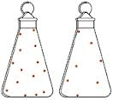
Answer the following in your notes:
What do you suppose is between the dots (which represent air molecules)?
If you put a drinking straw in water, place your finger over the opening, and lift the straw out of the water, some water stays in the straw. Explain.

Slide 17
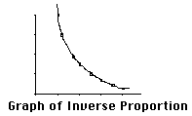
INVERSE PROPORTIONS
As one variable goes up, the other goes down!
Produces a
curved graph…
P
T
constant
V
AWESOME!!

Slide 18
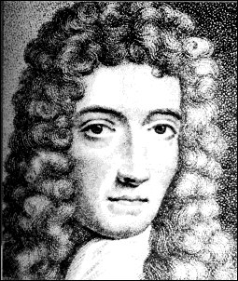
A. Boyle’s Law
PV = k

Slide 19
Boyle's Law
P₁ x V₁ = P₂ x V₂
P may change and V may change, but their product stays the same!
Multiplying the two variables equals a constant.

Slide 20
P₁V₁=P₂V₂ Boyle’s Law
A gas filled syringe has a volume of 150mL and a starting pressure of 0.947atm. If the pressure is increased to 0.987 atm what is the new volume?
Given:
P₁= 0.947 atm
V₁= 150mL= 0.15L
P₂= 0.987 atm
V₂ = ????
V₂ = P₁V₁ = P₂
V₂ = 0.947 atm (.15L) = 0.987 atm

Slide 21
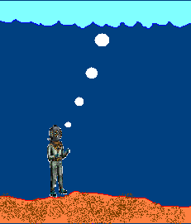
Problem:
A deep sea diver is working at a depth where the pressure is 3.0 atmospheres. He is breathing out air bubbles. The volume of each air bubble is 2 cm³. At the surface the pressure is 1 atmosphere. What is the volume of each bubble when it reaches the surface?

Slide 22
Boyle
In a thermonuclear device,the pressure of the 0.50 L of gas within the bomb casing reaches 4.0x10⁶atm. When the bomb casing is destroyed by the explosion, the gas is released into the atmosphere where it reaches a pressure of 1.00 atm. What is the volume of the gas after the explosion?

Slide 23
P1V1 = P2V2 V2 = P1V1 .
P2
V2 = (4.0 x 10⁶ atm)(0.50 L) .
(1.00 atm)
V2 = 2.0 x 10⁶ L
Boyle

