Slide 1
Laci Peterson
What happened in this case?
Classify the type of evidence
According to Scott Peterson, he was going fishing in the delta mid-day?
Why was this statement in question?
With Laci Peterson’s body in the salt water, how would you expect this to alter the process of decomposition?

Slide 2
Common Types of Physical Evidence
Blood, semen, saliva
Documents
Drugs
Explosives
Fibers
Fingerprints
Firearms and ammunition
Glass
Hair
Impressions

Slide 3
Common Types of Physical Evidence cont’d
organs and physiological fluids
paint
petroleum products
plastic bags
plastic, rubber, and other polymers
powder residues
serial numbers
soil and minerals
tool marks
vehicle lights
wood and other vegetative matter

Slide 4
Identification
Involves determining exactly what something is.
Examples: Illicit drugs, explosive residues, species determination of blood, semen, hair or wood.
Standards must be previously tested and identified (positive controls)
Sometimes a combination of five or six different tests are needed.
Quality and quantity of the specimen is a very important consideration

Slide 5
Comparison
Do the suspect specimen and the reference sample have a common origin?
Examples: hair from crime scene and from a suspect’s head, paint chip from hit and run and suspect vehicle.
Specific properties or characteristics are chosen for comparison.
Which ones and how many will vary.
If one or more properties do not agree, then it can be assumed the specimen and reference sample did not come from the same source.
If all properties match there is still no guarantee that the two specimens come from the same source.

Slide 6
Characteristics of evidence
Class characteristics
Individual characteristics
features that place the item into a specific category
features that distinguish one item from another of the same type

Slide 7
Individual characteristics
Evidence that that can be associated with a common source to a high degree of probability is said to possess individual characteristics.
Examples: Fingerprints, random and irregular wear patterns in tire or footwear impressions, handwriting, the fitting together of the irregular edges of broken objects like in a jigsaw puzzle.
Notes:
In most of these cases, it is not possible to state with mathematical certainty the probability that the specimens are of common origin, it can only be concluded that the probability is so high as to defy mathematical calculations

Slide 8
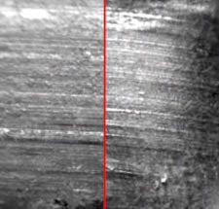
Striation marks
Notes:
The body of a woman was found with evidence of beating about the head and a stab wound to the neck. Her husband was charged with murder. The pathologist found a knife blade tip in the wound in the neck. The knife blade tip was compared with the broken blade of a penknife found in the trousers pocket of the accused. Scratch marks running across the blade tip correspond in detail to those on the broken handle.

Slide 9
The body of a woman was found with evidence of beating about the head and a stab wound to the neck. Her husband was charged with murder. The pathologist found a knife blade tip in the wound in the neck. The knife blade tip was compared with the broken blade of a penknife found in the trousers pocket of the accused. Scratch marks running across the blade tip correspond in detail to those on the broken handle.

Slide 10
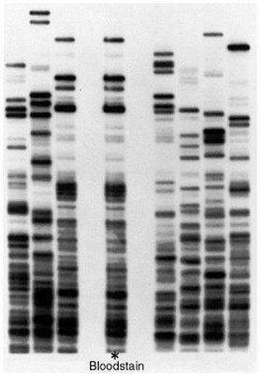
DNA Fingerprint
Notes:
Multilocus comparison of a forensic bloodstain (centre lane) shows the DNA microsatellite banding pattern to be identical with that of the individual in the third lane from the left. Estimation of the probably of obtaining such a match by chance requires knowledge of the allele frequencies at all of the component loci. Use of multiple markers can reduce the probability of such a "false positive" to several orders of magnitude less than the inverse of the total number of humans that have ever lived.

Slide 11
Class characteristics
Evidence is said to have class characteristics when it can be associated only with a group and not to an individual
Example: single layer auto paint chip – (can be matched to a make and model of car of which there could be thousands) vs. a paint chip with seven layers not all of which was part of the car’s original color (high probability of originating from one car)

Slide 12
The Value of Evidence:
Forensic analysis goes beyond just comparing colors – many chemical and or physical properties are examined
Physical evidence may also serve to exclude or exonerate a person

Slide 13
Product Rule
Used to calculate the frequency of occurrence of a type of class evidence
Multiplying together the frequency of each characteristic will determine the likelihood of the factors occurring together. As long as the events occur independently.

Slide 14
OJ Simpson Case
A blood stain at the crime was found to contain a number of factors that compared to OJ’s blood:
Blood factor: | Frequency in the general population:
A | 26%
EsD | 85%
PGM 2+2- | 2%

Slide 15
Product rule:
(.26)(.85)(.02) = 0.0044 or .44% of the population is a match.
Taking the reciprocal of 0.0044 will tell you that is about 1 in 227 people.

Slide 16
The Significance of Physical Evidence
Probability values cannot be assigned to most class physical evidence
The statistical data is not available and many items are mass produced
Its value lies mainly in its ability to corroborate events with data that is free from human bias and error

Slide 17
What is good Evidence?
Prove that a crime has been committed
corroborate testimony
link a suspect with a victim or with a crime scene
establish the identity of a persons associated with a crime
allow reconstruction of events of a crime

Slide 18
Rules of Evidence:
define what evidence is acceptable and how it can be used for the jury
Must be probative
meaning that it must prove something and address the issue of the particular crime
Hearsay
is generally inadmissible in criminal court because it is not reliable nor was it taken under oath
is admissible in civil court

Slide 19
Role of Probability
To comprehend the evidential value of a comparison, one must appreciate the role that probability has in ascertaining the origins of two or more specimens.
Simply defined, probability is the frequency of occurrence of an event.
In flipping a coin, probability is easy to establish.
With many analytical processes exact probability is impossible to define.

Slide 20
Probability
“The probability of showers Tuesday is 80%”
“The odds of the Detroit Tigers winning two consecutive baseball games is 20:1”
The Law:
probable cause
probative
probability of an accidental match
weight of evidence
beyond a reasonable doubt

Slide 21
P= 1 x 1 etc.
P₁ P₂
P=probability
if P=0 event will not occur
if P=1 event will occur

Slide 22
Example
probability of someone wearing red in class is 6 out of 24, or 1 out of 4
if there are 1,000 students in your school
statistically there should be 250 wearing something red
if there is only one student wearing yellow
1 out of 24
The probability of finding a student wearing red and yellow is:
1 x 1 = 1 therefore, P = 0.01
4 24 96
multiplying P by the population give 10 students

Slide 23
Mathematical Probabilities:
The Professor, the Prosecutor, and the Blonde With the Ponytail
Notes:
Just before noon on the 18th of June, 1964, in Los Angeles, an elderly lady by the name of Juanita Brooks was walking home from grocery shopping. As she made her way down an alley, she stooped to pick up an empty carton, at which point she suddenly felt herself being pushed to the ground. When she looked up, she saw a young woman with a blond ponytail running away down the alley with her purse. Near the end of the alley, a man named John Bass saw a woman run out of the alley and jump into a yellow car. The car took off and passed close by him. Bass subsequently described the driver as black, with a beard and a mustache. He described the young woman as Caucasian, slightly over five feet tall, with dark blond hair in a ponytail. Several days later, the LA Police arrested Janet Louise Collins and her husband Malcolm Ricardo Collins and charged them with the crime. Unfortunately for the prosecutor, neither Mrs. Brooks nor Mr. Bass could make a positive identification of either of the defendants. Instead, the prosecutor called as an expert witness a mathematics instructor at a nearby state college to testify on the probabilities that, he claimed, were relevant to the case

Slide 24
Just before noon on the 18th of June, 1964, in Los Angeles, an elderly lady by the name of Juanita Brooks was walking home from grocery shopping. As she made her way down an alley, she stooped to pick up an empty carton, at which point she suddenly felt herself being pushed to the ground. When she looked up, she saw a young woman with a blond ponytail running away down the alley with her purse. Near the end of the alley, a man named John Bass saw a woman run out of the alley and jump into a yellow car. The car took off and passed close by him. Bass subsequently described the driver as black, with a beard and a mustache. He described the young woman as Caucasian, slightly over five feet tall, with dark blond hair in a ponytail. Several days later, the LA Police arrested Janet Louise Collins and her husband Malcolm Ricardo Collins and charged them with the crime. Unfortunately for the prosecutor, neither Mrs. Brooks nor Mr. Bass could make a positive identification of either of the defendants. Instead, the prosecutor called as an expert witness a mathematics instructor at a nearby state college to testify on the probabilities that, he claimed, were relevant to the case

Slide 25
The prosecutor asked the mathematician to consider 6 features pertaining to the two perpetrators of the robbery:

Slide 26
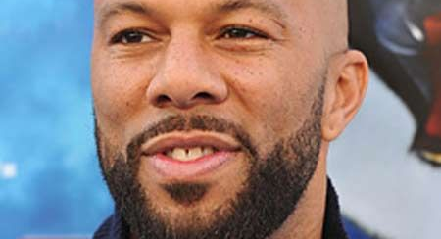
Black man with a beard

Slide 27
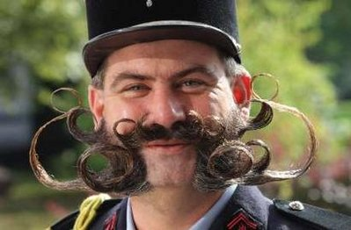
Man with a mustache

Slide 28
White woman with blonde hair

Slide 29
Woman with a ponytail

Slide 30
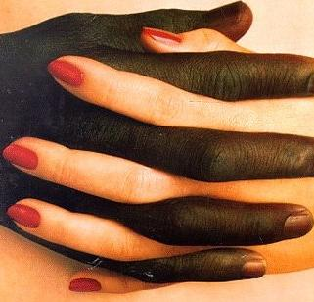
Interracial couple in a car

Slide 31
Yellow car

Slide 32
Next the prosecutor gave the mathematician some numbers to assume as the probabilities that a randomly selected (innocent) couple would satisfy each of those descriptive elements.
The mathematician described the product rule:
if two events are independent, then the probability that both events occur together is obtained by multiplying their individual probabilities.

Slide 33
The complete list of probabilities the prosecutor asked the mathematician to assume was:
Black man with a beard: 1 out of 10
Man with mustache: 1 out of 4
White woman with blonde hair: 1 out of 3
Woman with a ponytail: 1 out of 10
Interracial couple in car: 1 out of 1000
Yellow car : 1 out of 10

Slide 34
According to this rule, the witness testified,
P(black man with a beard AND has a mustache) =
P(black man with a beard) x P(has a mustache) =
1/10 x 1/4 = 1/(10 x 4) = 1/40

Slide 35
Based on these figures, the mathematician then used the product rule to calculate the overall probability that a random couple would satisfy all of the above criteria, which he worked out to be 1 in 12 million.
Impressed by those long odds:
the jury found Mr. and Mrs. Collins guilty as charged.
But did they make the right decision?
Was the mathematician's calculation correct
Malcolm Collins said it was not, and appealed his conviction.

Slide 36
In 1968, the Supreme Court of the State of California handed down a 6-to-1 decision, and their written opinion has become a classic in the study of legal evidence. Generations of law students have studied the case as an example of the use (and misuse) of mathematics in the courtroom.

Slide 37
The Supreme Court's devastating deconstruction of the prosecution's "trial by mathematics" had three major elements:
Proper use of "math as evidence" versus improper use ("math as sorcery").
Failure to prove that the mathematical argument used actually applies to the case at hand.
A major logical fallacy in the prosecutor's claim about the extremely low chance of the defendants being innocent.

Slide 38
Math as evidence
The law recognizes two principal ways in which an expert's testimony can provide admissible evidence. The expert can testify as to his or her own knowledge of relevant facts, or he or she can respond to hypothetical questions based on valid data that has already been presented in evidence.
What is not allowed is for the expert to testify how to calculate an aggregate probability based on initial estimates that are not supported by statistical evidence, which is what happened in the Collins case.

Slide 39
Was the trial court's math correct?
A second issue was whether the math itself was correct.
Even if the prosecution's choice of numbers for the probabilities of individual features - black man with a beard, and so on - were supported by actual evidence and were 100% accurate, the calculation that the prosecutor asked the mathematician to do depends on a crucial assumption: that in the general population these features occur independently.
If this assumption is true, then it is mathematically valid to use the product rule to calculate the probability that the couple who committed the crime, if they were not Mr. and Mrs. Collins, would by sheer chance happen to match the Collins couple in all of these factors.

Slide 40
The court went on to perform another calculation: Assuming the prosecution's 1 in 12 million result, what is the probability that somewhere in the Los Angeles area there are at least two couples that have the six characteristics as the witnesses described for the robbers?
The justices calculated that probability to be over 40 percent.
not at all reasonable to conclude that the defendants must be guilty simply because they have the six characteristics in the witnesses' descriptions.

